Slide 1
FIT3143 PARALLEL COMPUTING
Lab #1 | Shared-Memory
Prime Search
Savin Vindiv De Alwis | 35221631
Shamle Imal Thilaksiri | 35512075
Serial C → POSIX Threads → OpenMP

Slide 2

FIT3143 | LAB #1
Task 1 | Serial Baseline
Parallel Computing · ~45 seconds
Approach – Odd Sieve Method
Example output
Search for every prime strictly below n.
Skip even candidates completely.
For each odd candidate, test every odd divisor until √candidate.
Store results by candidate index so output remains sorted.
Measure elapsed computation time with a monotonic clock.
O(n √n)
Input: n = 30
Primes: 2 3 5 7 11 13 17 19 23 29
Measured baseline at n = 10,000,000
Prime count: 664,579
Computation time: 1.2006749 s
This serial implementation is used as the baseline when comparing the parallel runtimes.
Main optimisation: avoiding even candidates and stopping at √candidate removes a large amount of
unnecessary work before parallelism is introduced.
Savin Vindiv De Alwis | Shamle Imal Thilaksiri

Slide 3
FIT3143 | LAB #1
Experimental Setup
Parallel Computing · Same machine for all measurements
Problem-size scaling
n = 1,000,000 to 30,000,000
30 different n values
Task 2 and Task 3 use 20 threads
Task 2 speedup graph is shown only up to n = 10,000,000, as selected for the presentation.
Thread scaling
Fixed n = 10,000,000
Thread count = 1 to 40
This lets us see performance before and after the available hardware thread count is reached.
Test computer
14 physical hardware cores
20 logical processors
Thread counts above 20 oversubscribe the available logical processors.
Savin Vindiv De Alwis | Shamle Imal Thilaksiri

Slide 4

FIT3143 | LAB #1
n = 30
Task 2 | POSIX Threads
3, 5, 7 9, 11, 13 15, 17, 19 21, 23, 25 27, 29 11
Parallel Computing · Parallel design
Workload partitioning
Example static partitioning
We use an odd-candidate array (flag array) [3 : n)
It is split into contiguous ranges – static block partitioning
Each worker receives roughly the same number of candidates and runs the serial prime check.
Any remainder is distributed one extra candidate at a time to the first workers.
Each thread writes only to its own section of the shared result array.
Each thread keeps a local prime count, which is added after pthread_join() – serial section
Thread 0 · Thread 1 · Thread 2 · Thread 3 · Thread 4
Each worker owns a disjoint range of candidate indices
Why no mutex in the main loop?
Each worker writes to a unique array range, so there is no race condition and the expensive prime test runs without a critical section.
Main limitation
Equal candidate counts do not guarantee equal work. Larger candidates can require more divisor tests.
Test computer: 14 physical cores | 20 logical processors
Savin Vindiv De Alwis | Shamle Imal Thilaksiri

Slide 5
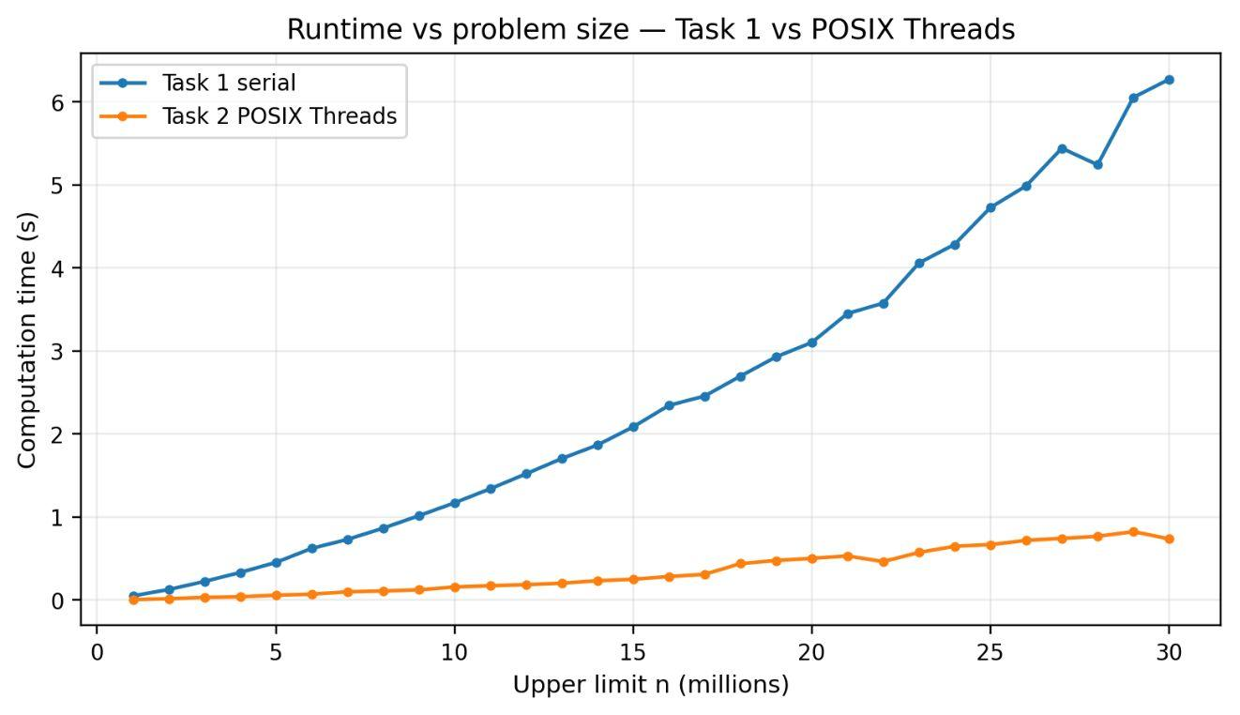
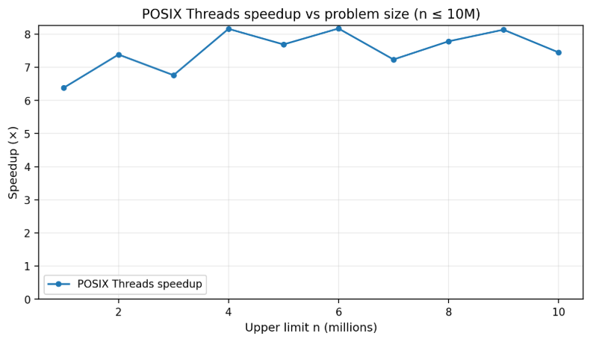
FIT3143 | LAB #1
Task 2 | Scaling with Problem Size
Parallel Computing · 20 POSIX Threads
Interpretation
Interpretation
At n = 30M, Task 1 takes 6.27 s while Pthreads takes 0.739 s.
Both runtimes increase with n, but the parallel implementation remains much faster across all 30 values.
For n ≤ 10M, measured speedup ranges from 6.38× to 8.17×; at 10M it is 7.45×.
Speedup is not monotonic, so the small rises and drops should not be interpreted as a fixed increasing or decreasing trend.
Savin Vindiv De Alwis | Shamle Imal Thilaksiri

Slide 6
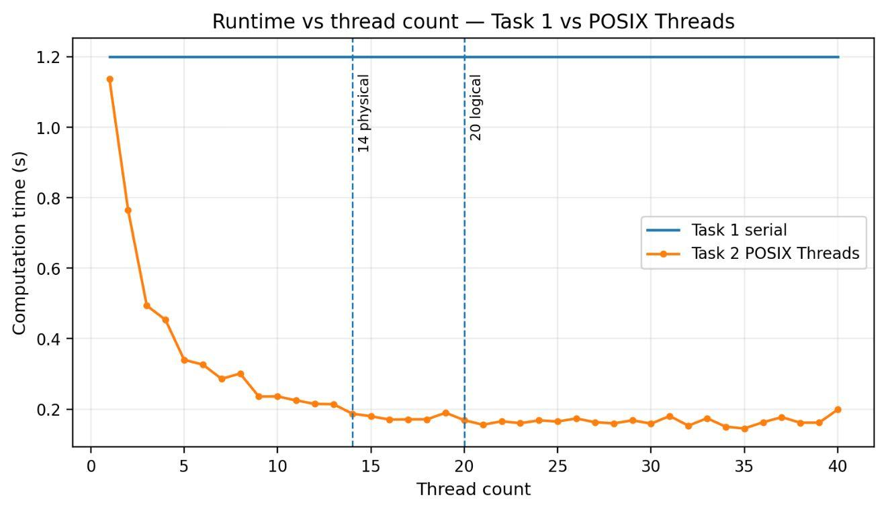
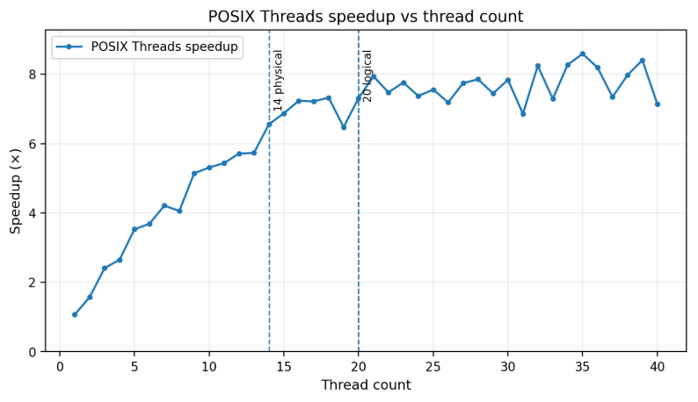
FIT3143 | LAB #1
Task 2 | Scaling with Thread Count
Parallel Computing · n = 10,000,000
Test computer: 14 physical hardware cores | 20 logical processors
Interpretation
Interpretation
Runtime falls to 0.187 s at 14 threads and 0.169 s at 20 threads as more hardware resources are used.
Above 20 threads the program is oversubscribed; results fluctuate, with the lowest single run 0.145 s at 35 threads.
Speedup is 6.56× at 14 threads and 7.31× at 20; the highest recorded value is 8.59× at 35 threads.
Scaling is clearly sub-linear (due to Amdahls’s law): adding threads continues to help in some runs, but the gain per extra thread becomes smaller and less predictable.
Savin Vindiv De Alwis | Shamle Imal Thilaksiri

Slide 7
FIT3143 | LAB #1
Task 3 | OpenMP
Parallel Computing · Parallel design
#pragma omp parallel for default(none)
shared(is_prime, odd_count, partition_count)
num_threads(thread_count) schedule(static)
reduction(+ : prime_count)
schedule (static)
Each partition iteration is assigned deterministically, giving low scheduling overhead.
reduction (+)
What OpenMP handles
Local prime counts are combined safely without an explicit mutex or critical section.
The runtime creates the worker team, executes the partition loop in parallel, and combines local prime counts using reduction.
Workload Distribution
Race condition
OpenMP reduction → Total prime count
Same algorithm
The odd-only prime test and √candidate stopping rule are unchanged from Tasks 1 and 2.
Savin Vindiv De Alwis | Shamle Imal Thilaksiri

Slide 8
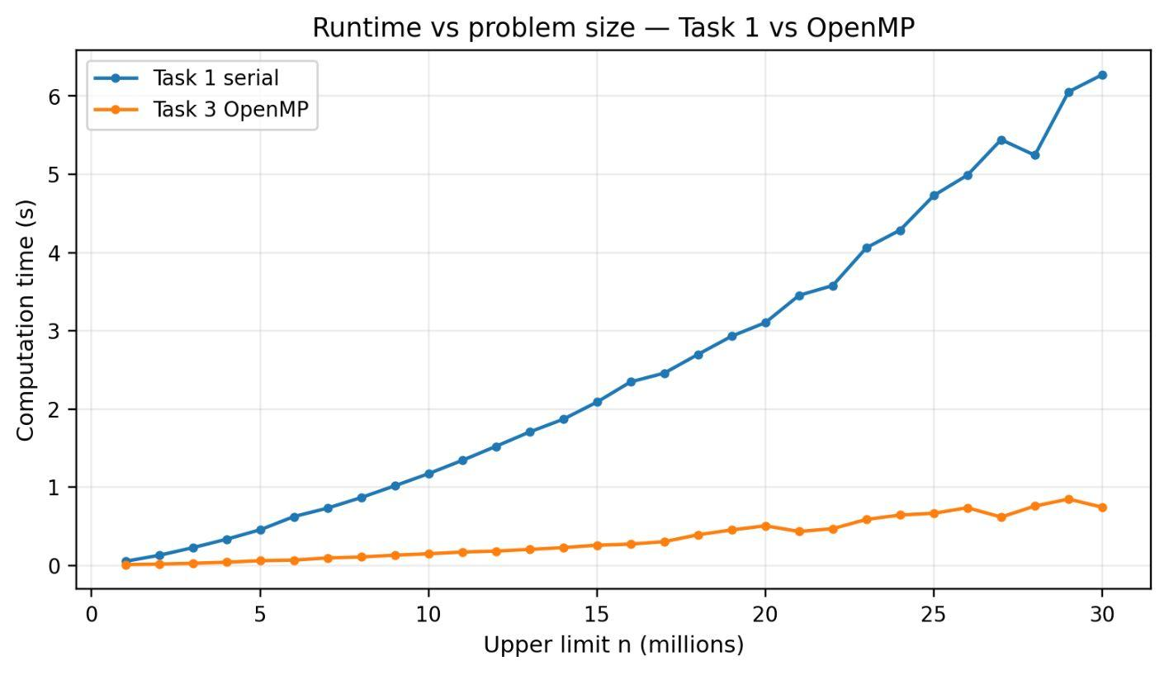
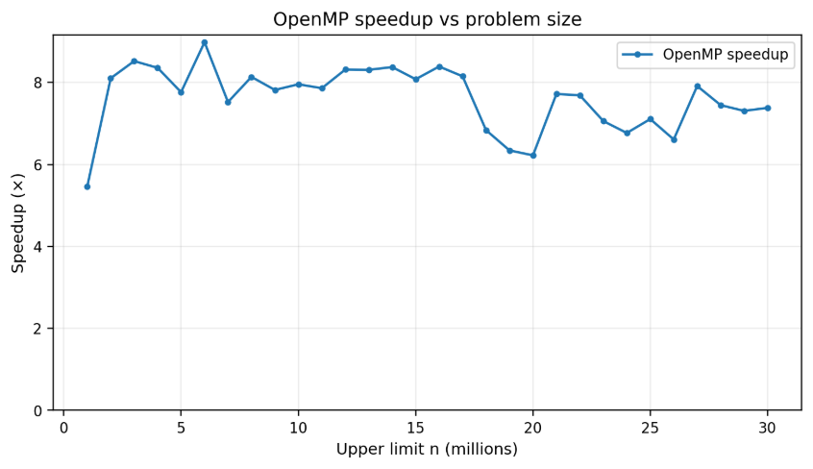
FIT3143 | LAB #1
Task 3 | Scaling with Problem Size
Parallel Computing · 20 OpenMP threads
Interpretation
Interpretation
At n = 30M, Task 1 takes 6.27 s while OpenMP takes 0.743 s.
OpenMP remains well below the serial runtime for every problem size, showing a strong shared-memory speedup.
OpenMP speedup is mostly around 7–8×, with a peak of 8.98× at n = 6M.
The dips around 18–20M show that the single-run measurements are variable rather than a smooth monotonic curve.
Savin Vindiv De Alwis | Shamle Imal Thilaksiri

Slide 9
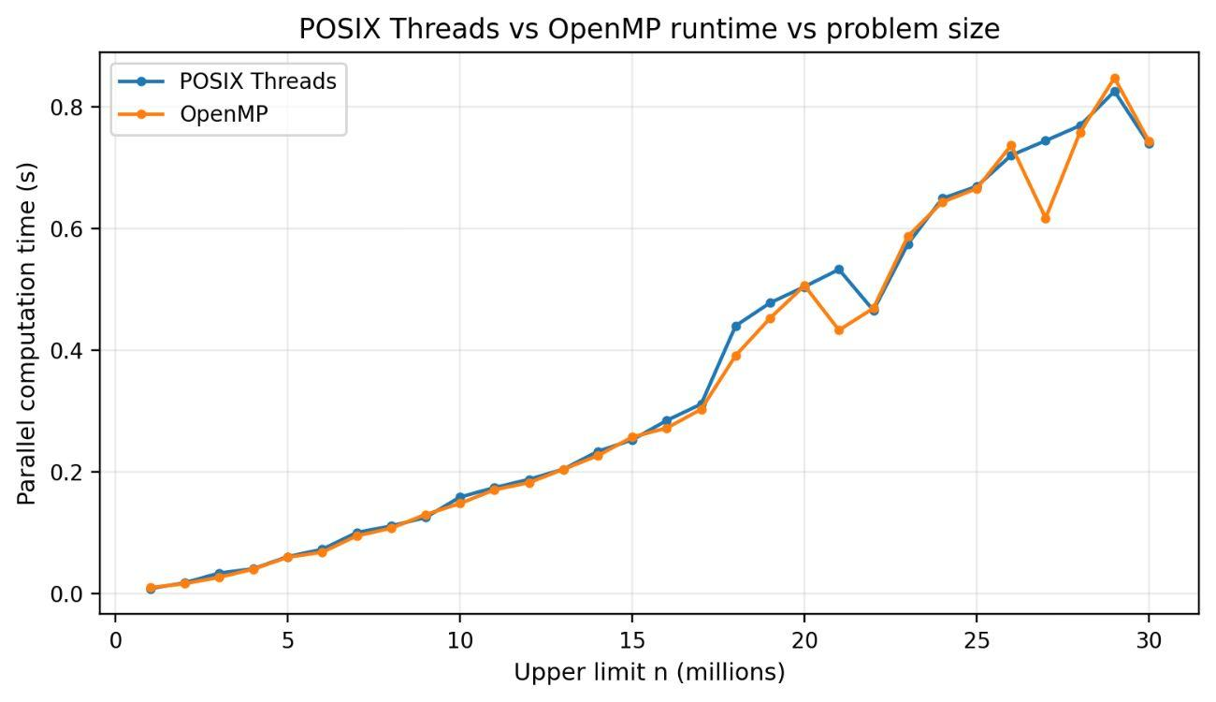
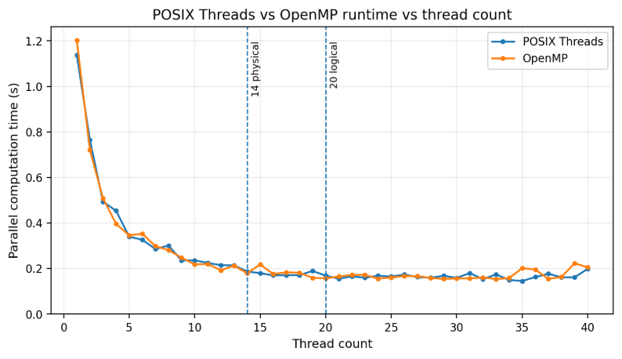
FIT3143 | LAB #1
Task 3 | POSIX Threads vs OpenMP
Parallel Computing · Direct comparison
Interpretation
Interpretation
OpenMP is faster in 21 of 30 problem-size measurements; mean time is 0.339 s vs 0.350 s for Pthreads.
The difference is small and inconsistent, so these data do not support saying OpenMP is always faster.
Across 1–40 threads, Pthreads is faster at 21 points and OpenMP at 19; mean times are almost identical (0.244 s vs 0.246 s).
After 20 logical processors both curves flatten and fluctuate, which is expected once software threads oversubscribe the hardware.
Savin Vindiv De Alwis | Shamle Imal Thilaksiri
Thread-scaling comparison uses the same machine: 14 physical cores | 20 logical processors.

Slide 10
FIT3143 | LAB #1
Conclusion & Recommendations
Main results
What limits speedup
Task 2 and Task 3 produce the same prime counts as Task 1.
Both parallel implementations are substantially faster than the serial version.
Pthreads and OpenMP give broadly similar performance on this workload.
Thread creation and scheduling overhead.
Static contiguous partitions balance candidate count, not exact computational cost.
Above 20 logical processors the machine is oversubscribed.
Single-run timing introduces visible noise.
What we would improve
Overall: OpenMP is simpler to express, while Pthreads gives more explicit control. On this dataset, performance is close enough that neither is a universal winner.
Repeat each configuration multiple times and use a mean/median.
Add error bars.
Compare static contiguous partitioning against cyclic or dynamic scheduling.
Benchmark an unoptimised Task 1 version to quantify the serial optimisation.
Consider dynamic scheduling
Savin Vindiv De Alwis | Shamle Imal Thilaksiri

Slide 11
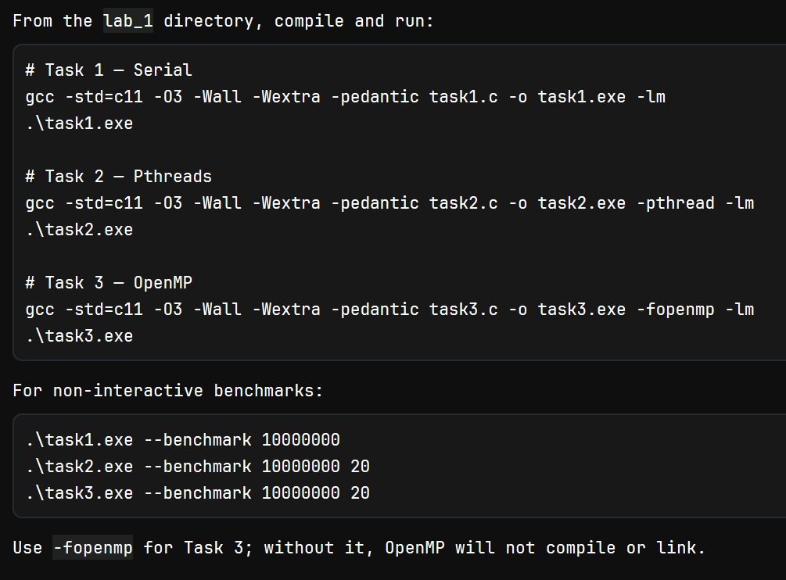
FIT3143 | LAB #1
Appendix - Run Instructions
Parallel Computing · Same machine for all measurements
Run these commands from the directory that the .C files are stored in
Savin Vindiv De Alwis | Shamle Imal Thilaksiri

Slide 12
FIT3143 | LAB #1
Appendix - AI Declaration
Generative AI was used during preparation to help organise presentation content and create charts from the team’s supplied CSV measurements.
The source code, measured results, interpretation, and final submitted material remain the responsibility of the team.
Savin Vindiv De Alwis | Shamle Imal Thilaksiri

